Slide 1
Chapter Four
Data Link Layer

Slide 2
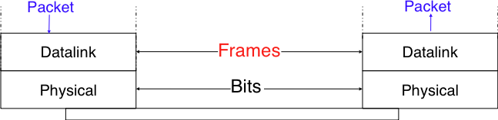
Introduction
The second layer in OSI reference model
uses the service provided by the physical layer.
receives packets from the network layer.
Two datalink layer entities exchange frames.
The data link layer has a number of specific functions it can carry out.
These functions include:
  Providing a well-defined service interface to the network layer.
  Regulating the flow of data so that slow receivers are not swamped by fast senders.
  Dealing with transmission errors.

Slide 3
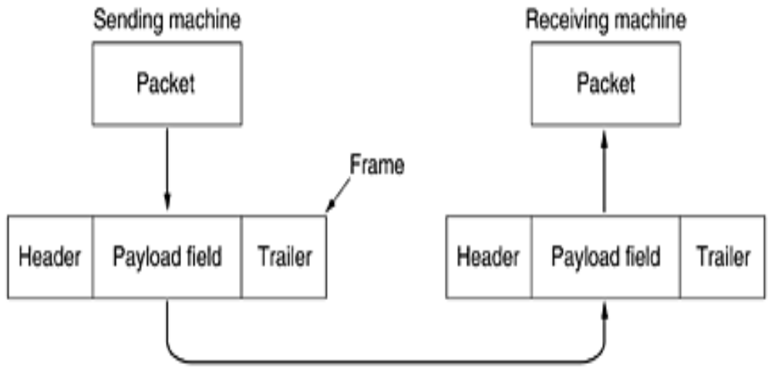
Each frame contains
  frame header,
  payload field for holding the packet,
  frame trailer

Slide 4
Services Provided to the Network Layer
The principal service is
  transferring data from the network layer on the source machine to the network layer on the destination machine
Three services that are commonly provided are:
  Acknowledged connectionless service.
    no logical connection is set up between the host machines
    Each frame sent is individually acknowledged
    The sender knows whether a frame has arrived correctly.
      If it has not arrived within a specified time interval, it can be sent again
    Used in WiFi (IEEE 802.11) services

Slide 5
  Unacknowledged connectionless service.
    The source machine send independent frames to the destination machine without having the destination machine acknowledge them
    No logical connection is set up between the host machines.
    If a frame is lost due to noise on the line, no attempt is made to detect the loss or recover from it in the data link layer
    Appropriate when:
      the error rate is very low so that recovery is left to higher layers
      appropriate for real-time traffic, such as voice communication, in which late data are worse than bad data
      Is also applicable in Ethernet services

Slide 6
  Acknowledged connection-oriented service.
    Best service that data link layer offers
    A logical connection is set up between the two machines and the data is transmitted along this logical path
    Each frame sent over the connection is numbered,
      that keeps track of loss of frames and also
      ensures that frames are received in correct order
    The service has three distinct phases
      Set up of connection
      Sending frames
      Release connection
    It is appropriate for
      satellite communications and
      long-distance telephone circuits.

Slide 7
Framing
is the division of stream of bits from the network layer into manageable units (called frames).
Each frame consists of the sender’s address and a destination address.
Frames could be of fixed size or variable size.
fixed-size framing,
  there is no need for defining the boundaries of the frames as the size itself can be used to define the end of the frame and the beginning of the next frame
variable-size framing,
  we need a way to define the end of the frame and the beginning of the next frame.
To separate one frame from the next, an 8-bit (or 1-byte) flag is added at the beginning and the end of a frame.
  But the problem with that is, any pattern used for the flag could also be part of the information.

Slide 8
So, there are two ways to overcome this problem:
  Byte stuffing (or character stuffing)
  Bit stuffing
To enable a receiver to easily delineate the frame boundaries,
  these two techniques reserve special bit strings as frame boundary markers
  and encode the frames so that these special bit strings do not appear inside the frames.

Slide 9
Bit stufﬁng
  reserves the 01111110 bit string as the frame boundary marker
  and ensures that there will never be six consecutive 1 symbols transmitted by the physical layer inside a frame
  a frame is sent as follows.
    First, the sender transmits the marker, i.e. 01111110.
    Then, it sends all the bits of the frame and inserts an additional bit set to 0 after each sequence of ﬁve consecutive 1 bits.
    The marker is also sent to mark the end of the frame.
  The receiver performs the opposite to decode a received frame.
  increases the number of bits required to transmit each frame.

Slide 10
  If transmission errors occur, stuffed bits or markers can be in error.
  In these cases, the frame affected by the error and possibly the next frame will not be correctly decoded by the receiver,
    but it will be able to resynchronize itself at the next valid marker.
  The table below illustrates the application of bit stufﬁng to some frames.
Original frame | Transmitted frame
0001001001001001001000011 | 01111110000100100100100100100001101111110
0110111111111111111110010 | 01111110011011111011111011111011001001111110
01111110 | 0111111001111101001111110

Slide 11
  Bit stufﬁng can be easily implemented in hardware.
  However, implementing it in software is difﬁcult given the higher overhead of bit manipulations in software.
Character (Byte) Stuffing
  Some characters are used as markers to delineate the frame boundaries.
  Many character stufﬁng techniques use the DLE, STX and ETX characters of the ASCII character set.
  DLE STX is used to mark the beginning of a frame.
  DLE ETX is used to mark the end of a frame.
  When transmitting a frame, the sender adds a DLE character after each transmitted DLE character.
  The receiver detects the frame boundaries and removes the second DLE when it receives two consecutive DLE characters.

Slide 12
The following table illustrates the character stuffing
like bit stufﬁng, increases the length of the transmitted frames.
When transmission errors occur, the receiver may incorrectly decode one or two frames (e.g. if the errors occur in the markers).
However, it will be able to resynchronize itself with the next correctly received markers.
Original frame | Transmitted frame
1 2 3 4 | DLE STX 1 2 3 4 DLE ETX
1 2 3 DLE STX 4 | DLE STX 1 2 3 DLE DLE STX 4 DLE ETX
DLE STX DLE ETX | DLE STX DLE DLE STX DLE DLE ETX DLE ETX

Slide 13
Flow control
assuring that a transmitting entity does not overwhelm a receiving entity with data
  Slow receivers not swamped by fast senders
it is an end-to-end mechanism for regulating traffic between source and destination
Different methods
  Stop-and-Wait Flow Control
  Sliding-Window Flow Control

Slide 14
Stop-and-Wait Flow Control
  The simplest form of flow control
  Source transmits frame
  Destination receives frame and replies with acknowledgement
  Source waits for ACK before sending next frame
  Only one frame can be in transit at a time
  Destination can stop flow by not sending ACK
  Works well for a few frames

Slide 15
Sliding Windows Flow Control
  Allow multiple frames to be in transit
  Receiver has buffer W long
  Transmitter can send up to W frames without ACK
  Each frame is numbered
  ACK includes number of next frame expected
  Sequence number bounded by size of field (k)
    Frames are numbered modulo 2^{k}
  Efficient
    Many frames can be in transit

Slide 16
Key Differences Between Stop-and-Wait Protocol and Sliding Window Protocol
Basis for Comparison | Stop-and-Wait | Sliding Window
Behavior | Request and Reply | Simultaneously transmit
Number of frames | Only one | Multiple
Efficiency | Less | More comparatively
Acknowledgment | Sent for each arriving packet | Window of acknowledgement is maintained
Type of Transmission | Half Duplex | Full Duplex
Propagation Delay | Long | Short
Link Utilization | Poor | Better

Slide 17
Error detection
When an electromagnetic signal flows from one point to another, several things can change its shape and timing
If the signal is carrying encoded binary data, such changes can alter the meaning of the data
Causes of Error
  Attenuation: any reduction in the strength of a signal
  Delay Distortion: different propagation speeds of signals at different frequencies
  Noise: additional signals inserted between transmitter and receiver

Slide 18
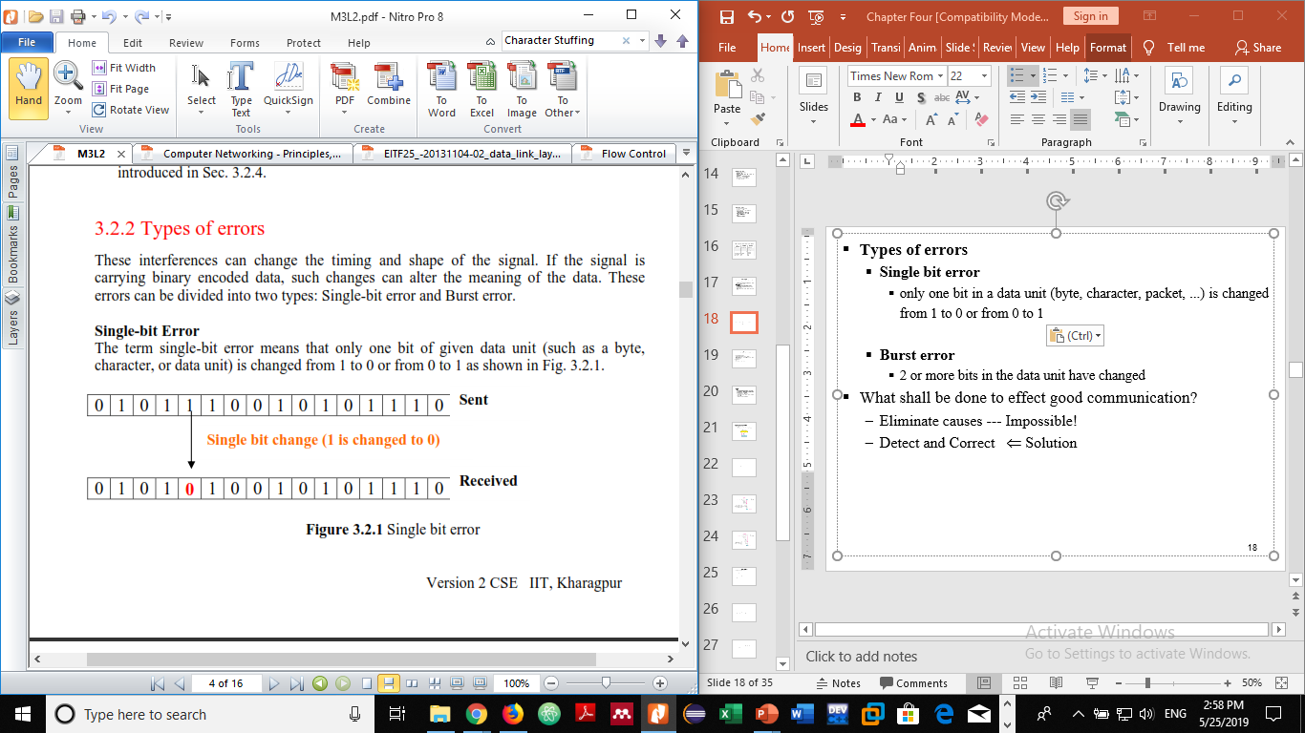
Types of errors
  Single bit error
    only one bit in a data unit (byte, character, packet, ...) is changed from 1 to 0 or from 0 to 1
    are least likely type of errors in serial data transmission
    However, a single-bit error can happen if we are having a parallel data transmission.
      For example, if 16 wires are used to send all 16 bits of a word at the same time and one of the wires is noisy, one bit is corrupted in each word.

Slide 19
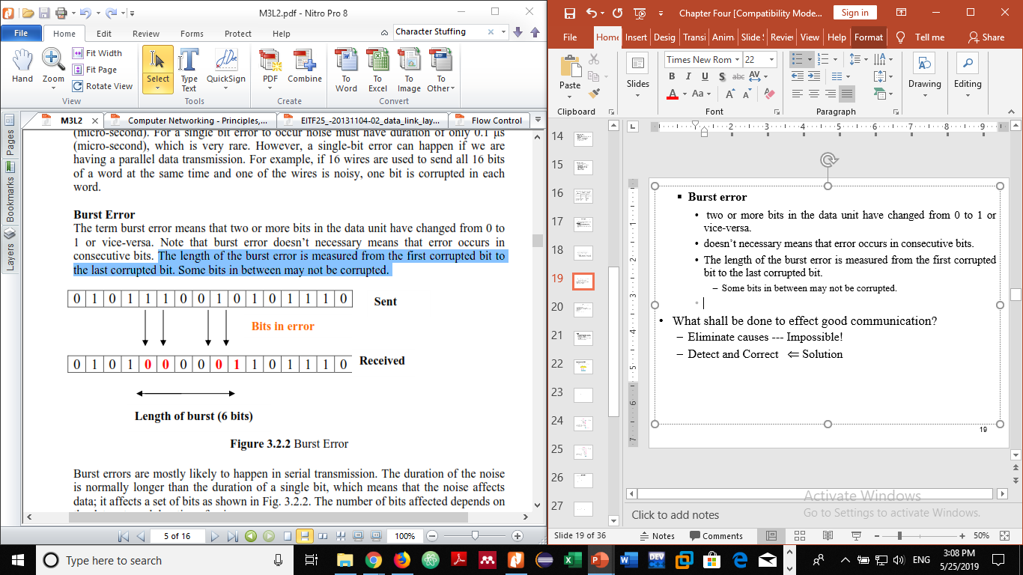
  Burst error
    two or more bits in the data unit have changed from 0 to 1 or vice-versa.
    doesn’t necessary means that error occurs in consecutive bits.
    The length of the burst error is measured from the first corrupted bit to the last corrupted bit.
      Some bits in between may not be corrupted.
    Burst errors are mostly likely to happen in serial transmission.
    The duration of the noise is normally longer than the duration of a single bit, which means that the noise affects data;
    it affects a set of bits
    The number of bits affected depends on the data rate and duration of noise.

Slide 20
Error Detection
Basic approach used for error detection is the use of redundancy,
  where additional bits are added to facilitate detection and correction of errors.
Three Methods
  Parity Check
  Checksum
  Cyclic Redundancy Check (CRC)

Slide 21
Parity Check
  a redundant bit, called a parity bit, is added to every data unit so that the total number of 1s in the unit (including the parity bit) becomes even (or odd for odd-parity);
  Blocks of data from the source are subjected to a check bit or Parity bit generator form,
    where a parity of 1 is added to the block if it contains an odd number of 1’s and 0 is added if it contains an even number of 1’s.
  this method can detect all single-bit errors;
  it can detect burst errors only if the total number of errors in each data unit is odd
  Even number of bit errors goes undetected

Slide 22
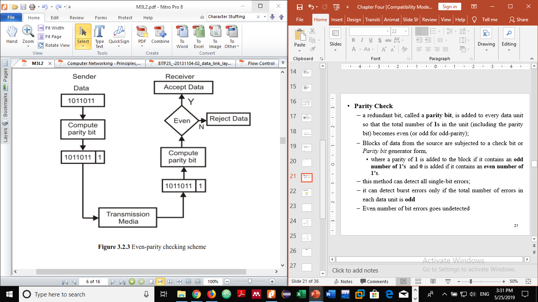
Even-parity Checking Scheme

Slide 23
Checksum
  the data is divided into k segments each of m bits.
  In the sender’s end the segments are added using 1’s complement arithmetic to get the sum.
  The sum is complemented to get the checksum.
  The checksum segment is sent along with the data segments.
  At the receiver’s end, all received segments are added using 1’s complement arithmetic to get the sum.
  The sum is complemented.
  If the result is zero, the received data is accepted; otherwise discarded

Slide 24
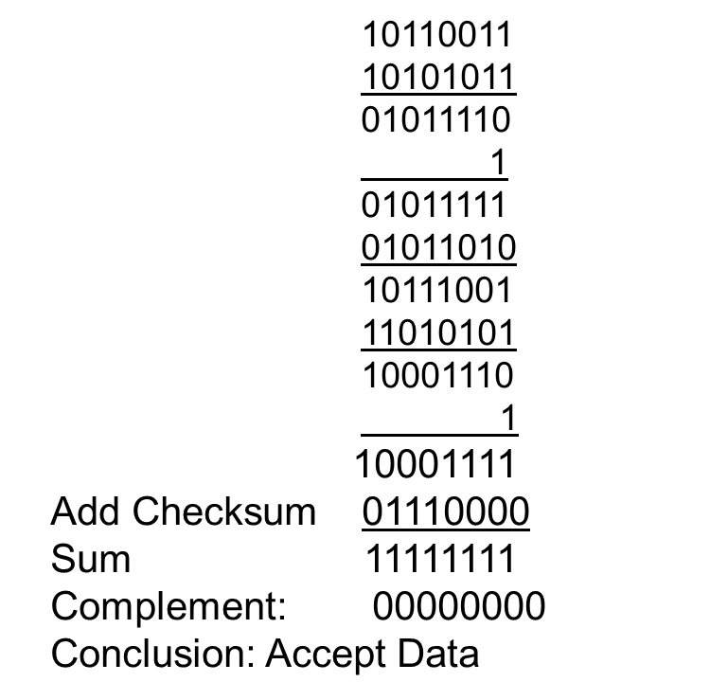
For example: Find the checksum at sender and receiver for the following segments. (k = 4 and m = 8)
  10110011, 10101011 01011010 11010101
  Sender Receiver
        10110011
        10101011
        01011110
        1
        01011111
        01011010
        10111001
        11010101
        10001110
        1
    Sum: 10001111
    Checksum: 01110000

Slide 25
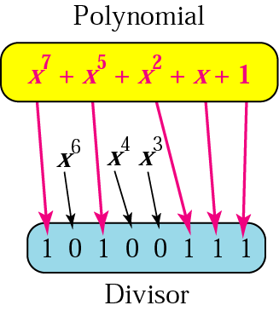
Cyclic Redundancy Check (CRC)
  is the most powerful and easy to implement technique.
  based on binary division
  a sequence of redundant bits, called cyclic redundancy check bits (CRC) are appended to the end of a data unit
    so that the resulting data unit becomes exactly divisible by a second, predetermined binary number

Slide 26
  append a string of n 0s into the data unit ( n = divisor bits # –1)
  divide result by the divisor using binary division
  remainder of division becomes the CRC
  replace the appended 0s with CRC
  Send data (original + CRC)
  Receiver divides the whole data by divisor
    If remainder ,⇒ERROR
    Otherwise ⇒ NO ERROR

Slide 27
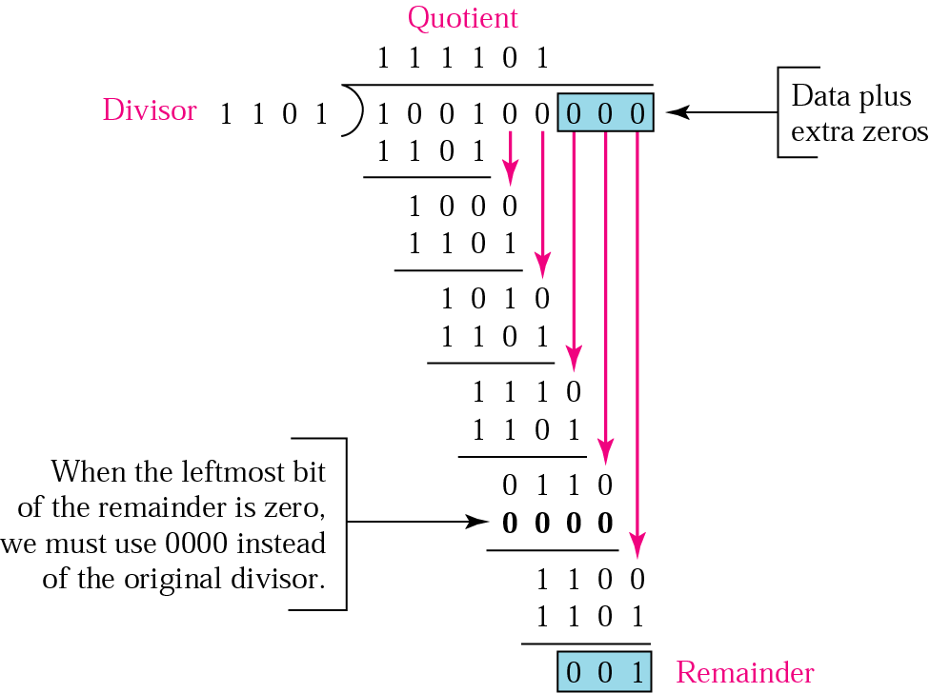

Slide 28
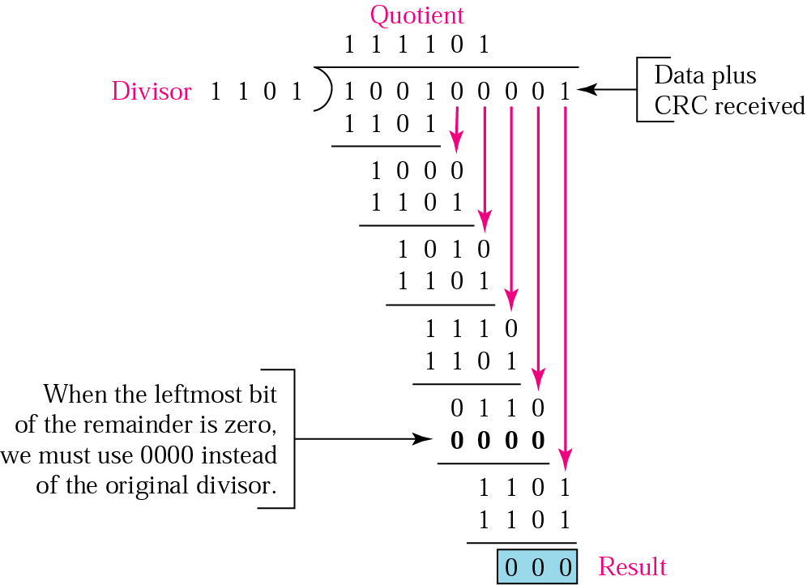

Slide 29
Error Control
Detection and correction of errors
  Lost frames
  Damaged frames
Automatic Repeat Request
  Error detection
  Positive acknowledgment
  Retransmission after timeout
  Negative acknowledgement and retransmission

Slide 30
ARQ
  Packets are numbered
  Positive acknowledgment (ACK) for successfully received packets
  Retransmission can be made if:
    Time expires (lost or corrupted)
    Received in error (NAK)
  Popular ARQ protocols are: Stop-and-wait, Selective Repeat and Go-Back-N

Slide 31
Stop-and-wait ARQ (SWA)
  Next packet is sent after previous packet acknowledgment
  Retransmission if time expires
  Numbered only to identify corresponding data packet and ACK
  Reasons for retransmission
    Damaged packets
    Lost packets
    Lost acknowledgment

Slide 32
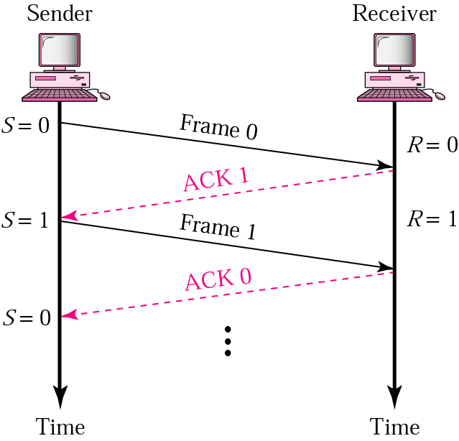
Normal operation

Slide 33
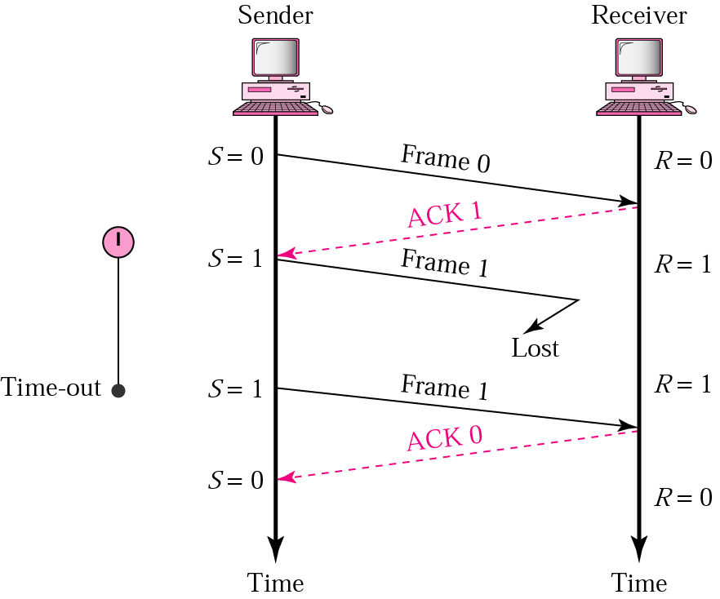
Lost frame

Slide 34
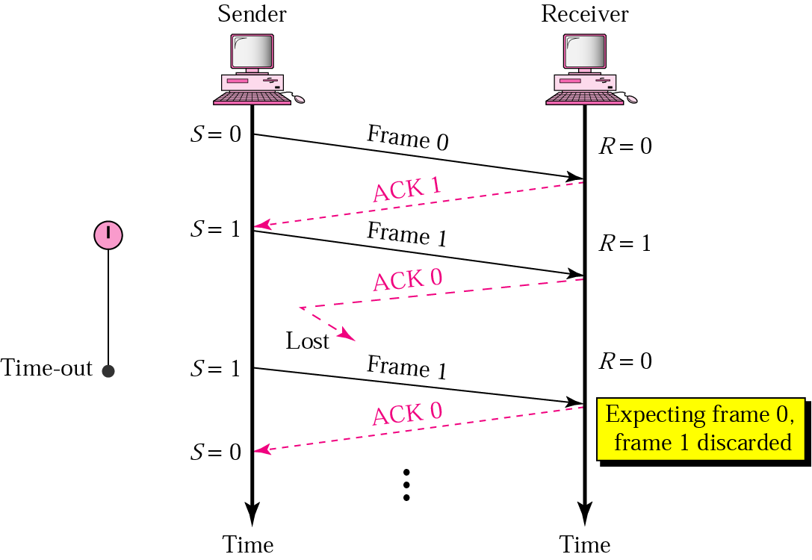
Lost ack

Slide 35
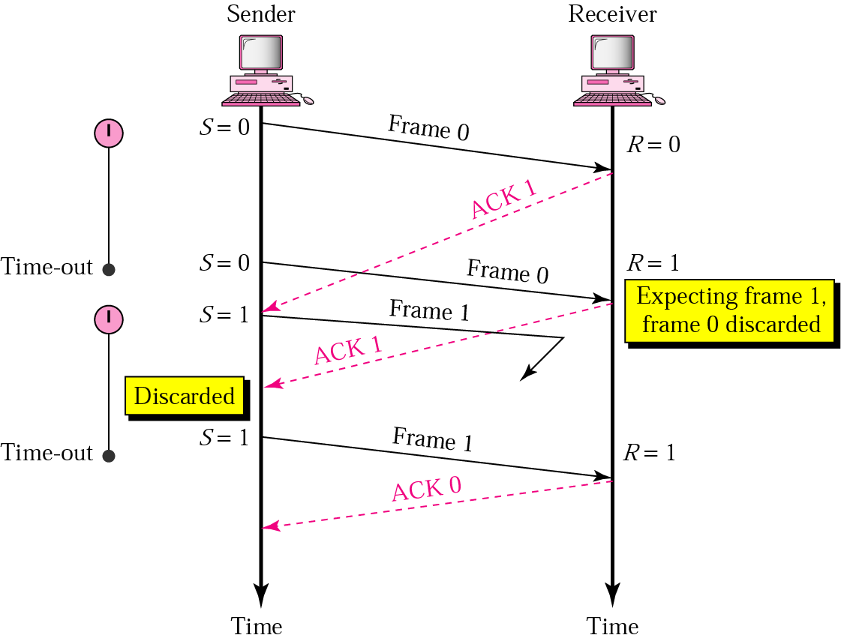
Delayed ack

Slide 36
Go-Back-N ARQ
  Continuous packet transmission like SRA
  Unlike SRA Out of order packets are discarded
  Time out packet and packets following are retransmitted
  Unlike SRA no buffering
  Like SWA no re-sequencing overhead
Go-Back-4:
4 frames are outstanding; so go back 4
fr
0
fr
1
fr
2
fr
3
fr
4
fr
5
fr
6
fr
3
fr
4
fr
5
fr
6
fr
7
fr
8
fr
9
time
A
B
ACK1
ACK2
ACK3
Out-of-sequence frames
ACK4
ACK5
ACK6
ACK7
ACK8
ACK9
error
ACKing next frame expected

Slide 37
Selective Repeat ARQ (SRA)
  Continuously transmission packets
  Packets are assigned sequence number
  Arrival of packets can be in any order
  Packets are buffered before delivery
  Increases data transfer rate compared to SWA
  Retransmission for
    Damaged packets
    Lost packets
    Lost acknowledgments

Slide 38
fr
0
fr
1
fr
2
fr
3
fr
4
fr
5
fr
6
fr
2
fr
7
fr
8
fr
9
fr
10
fr
11
fr
12
time
A
B
ACK1
ACK2
NAK2
ACK2
ACK2
ACK2
ACK7
ACK8
ACK9
ACK10
ACK11
ACK12
error

Slide 39
References
https://www.tutorialspoint.com/what-are-the-data-link-layer-services-provided-to-the-network-layer
https://techdifferences.com/difference-between-stop-and-wait-protocol-and-sliding-window-protocol.html
Olivier Bonaventure, Computer Networking: Principles, Protocol and practice, February 25, 2014

